Slide 1
INTERACTIVE CHILDREN’S STORYBOOK APPLICATION
TEAM :8
Dharshini N-727822TUCS032
Deva Dharshini S-727822TUCS029
Kanishka M-727822TUCS054
Andrey Flintoff G-727822TUCS010

Slide 2
OBJECTIVE
The objective of the Interactive Children’s Storybook application is to develop a comprehensive digital platform that fosters a love for reading and enhances learning among young users.
By utilizing React, this application will incorporate essential features, including a user-friendly book browsing experience, efficient search functionality, secure user authentication, a read-aloud option for accessibility, and interactive quiz activities.
The ultimate goal is to create a scalable, robust, and engaging platform that offers an intuitive and safe environment for children to explore stories, learn, and interact with educational content in a dynamic way.

Slide 3
FUNCTIONALITIES
.
Develop a comprehensive INTERACTIVE CHILDREN’S STORYBOOK application using React, integrating essential features to provide an intuitive, secure, and efficient learning experience for learners.
This includes functionalities such as books browsing, search, user authentication, read aloud option and quiz activities.

Slide 4
Tools and Technologies :
FRONTEND
React : 18.3.1
MUI for styling : 5.16.5
BACKEND
Spring Boot : 3.3.2
MySQL
Postman

Slide 5
FEATURES
Key Features
Interactive stories with read-aloud options.
Educational quizzes to reinforce learning.
Easy content management for admins.
Integration with Axios:
Used to fetch data from the backend and interact with APIs in the project.
Payment with Razor pay:
Integrated to handle payment processing within the application
Security with Spring Security
Used to secure API endpoints, manage user authentication, and enforce role-based access control in the project.

Slide 6
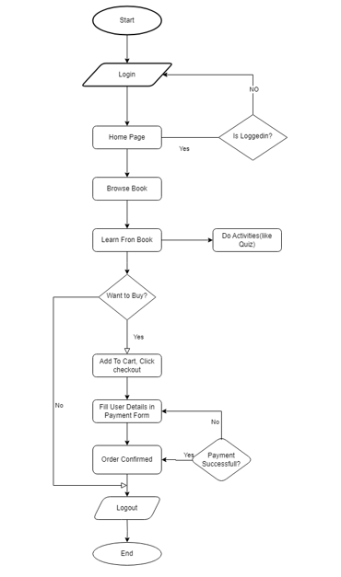
APPLICATION FLOW:

Slide 7
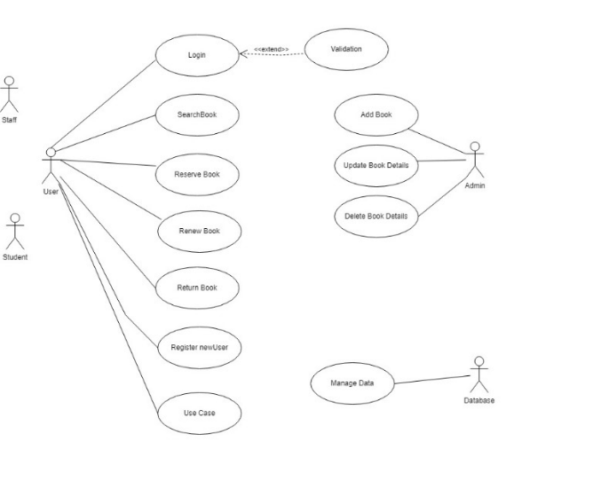
USE CASE DIAGRAM

Slide 8
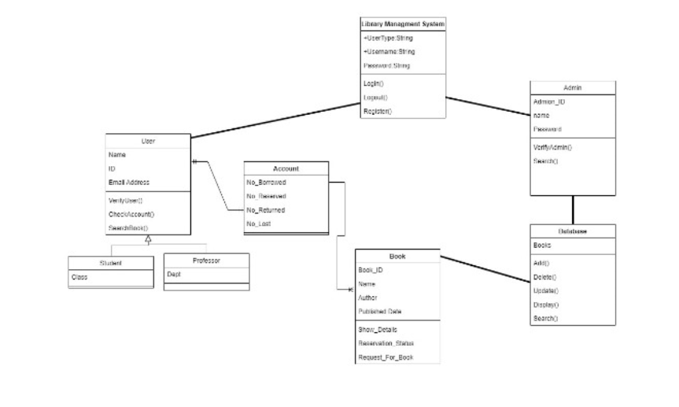
CLASS DIAGRAM

Slide 9
FRONTEND
The frontend of the Interactive Children’s Storybook application is built with React (18.3.1) for efficient, component-based development, allowing smooth, interactive user experiences.
Styling is handled by Material-UI (MUI 5.16.5), providing a modern, consistent design that is easy to navigate and visually appealing for young users. Together, React and MUI create a user-friendly, engaging interface that enhances the reading and learning experience.

Slide 10
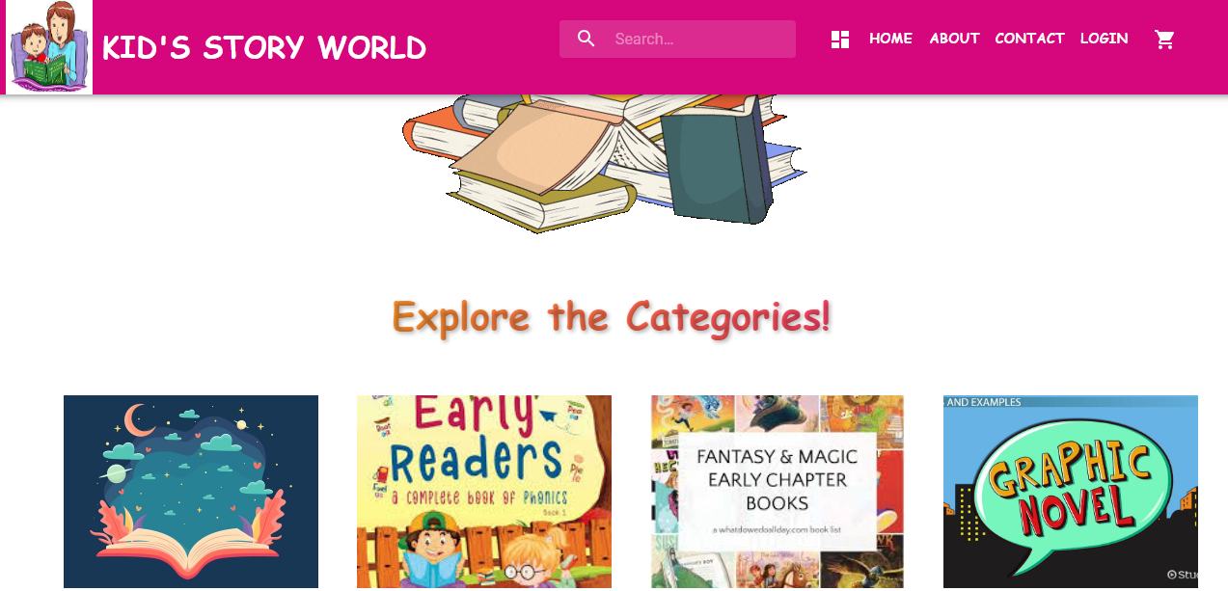
HOME PAGE

Slide 11
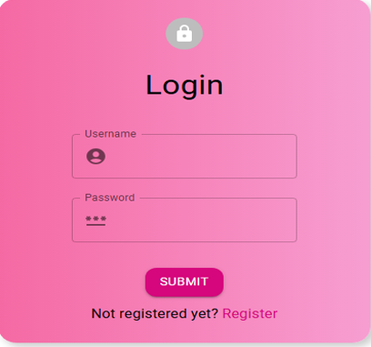
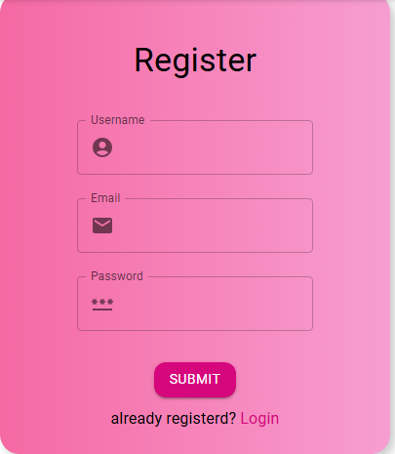
LOGIN AND REGISTER PAGE

Slide 12
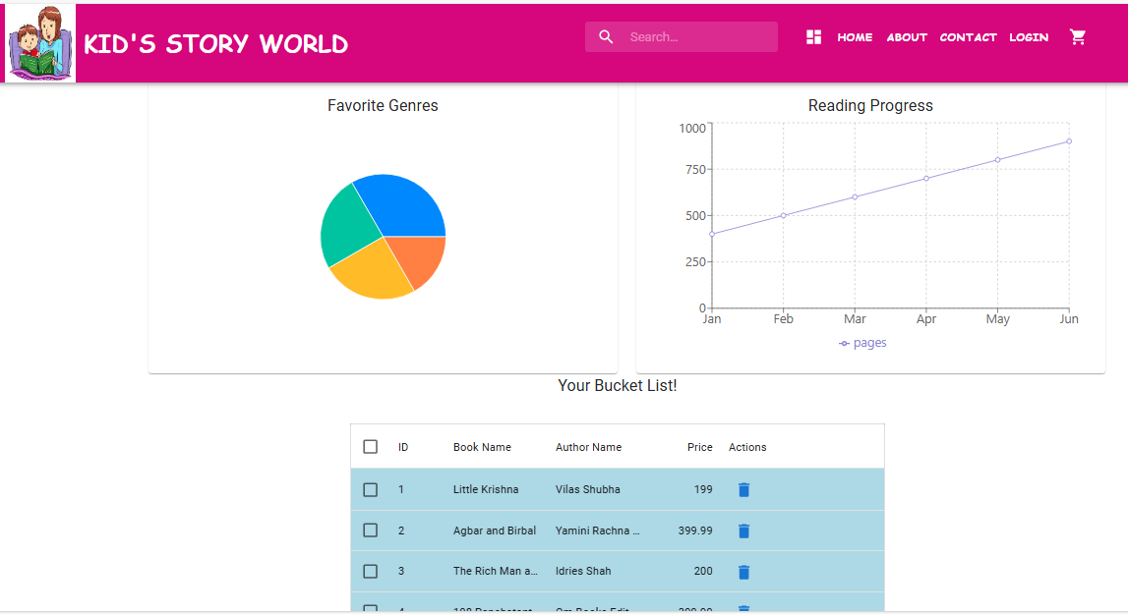
USER DASHBOARD

Slide 13
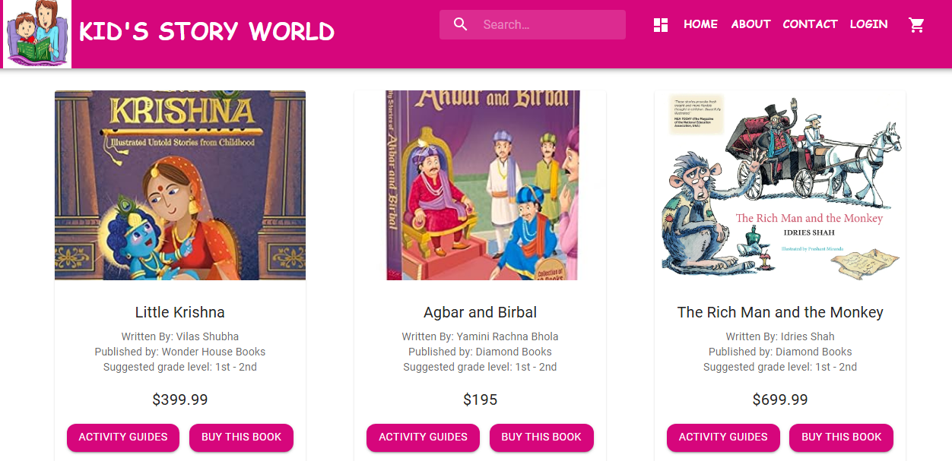
BOOKS CATALOG

Slide 14
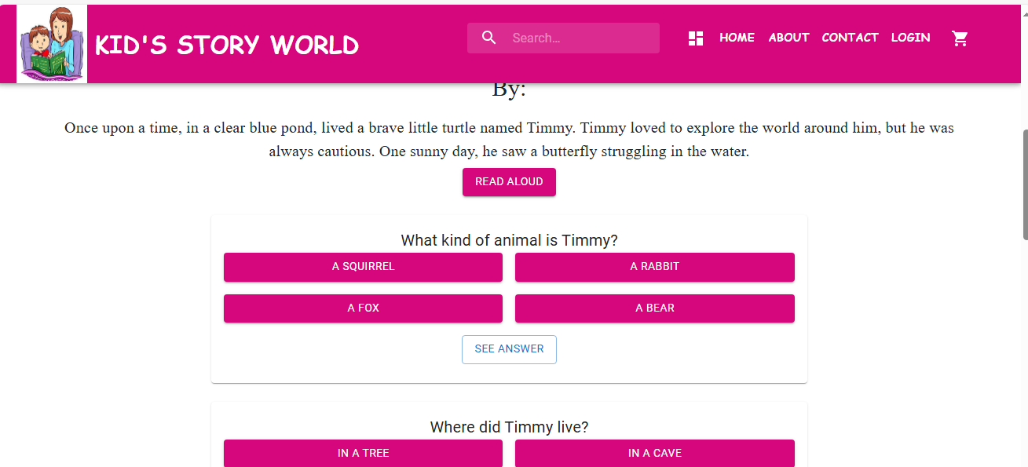
BOOKS DETAILS

Slide 15
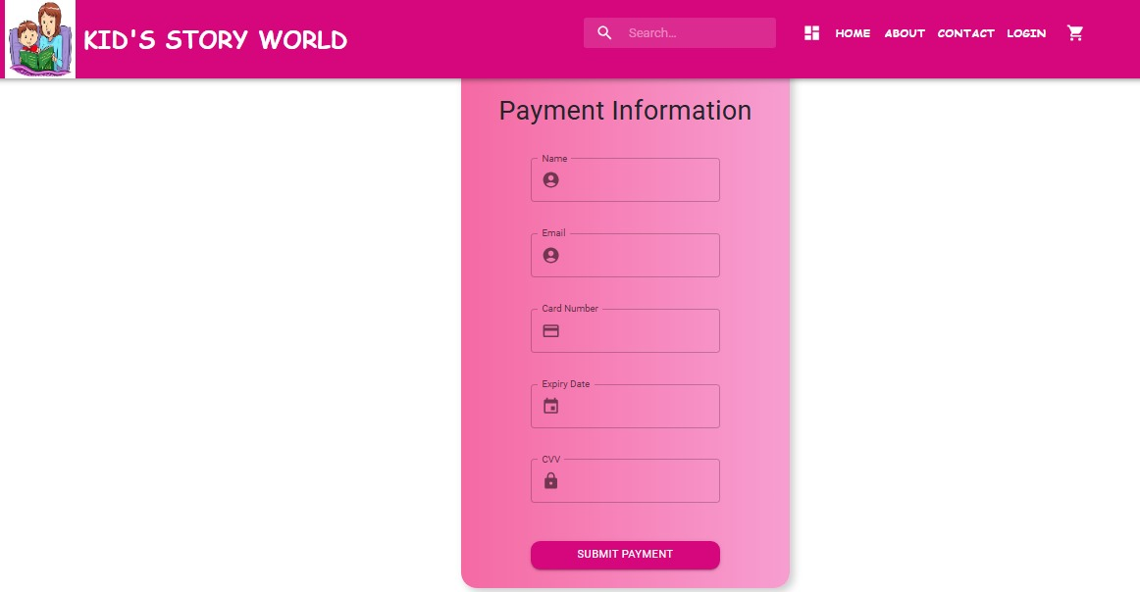

PAYMENT PAGE

Slide 16
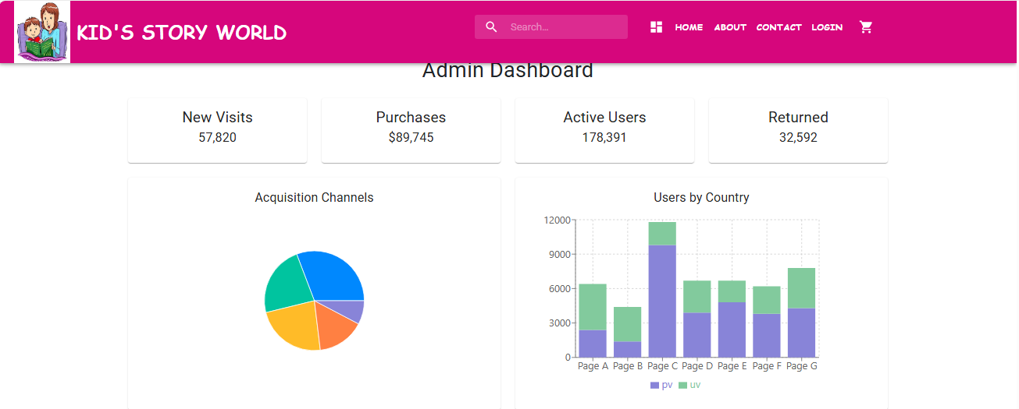
ADMIN DASHBOARD

Slide 17
BACKEND
The backend of the Interactive Children’s Storybook application is built using Spring Boot (3.3.2), a powerful Java framework that simplifies the development of robust and scalable backend services. Spring Boot handles the application’s core functionality, such as managing APIs, user authentication, and data processing, ensuring a secure and efficient experience.
For data storage, the application uses MySQL, a reliable and widely-used relational database. MySQL manages the storage of user data, book content, quiz results, and other essential information, enabling quick retrieval and updates as users interact with the application. Together, Spring Boot and MySQL provide a stable, secure, and scalable backend foundation that supports the frontend’s interactive features.

Slide 18
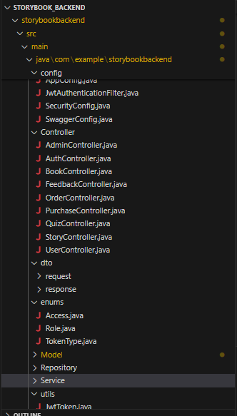
BACKEND LAYOUT
CLASSES USED:
USER
BOOK
STORY
QUIZ
FEEDBACK
ORDER
PURCHASE

Slide 19

SAMPLE OUTPUT

Slide 20
CONCLUSION
Our interactive children’s storybook app blends storytelling with learning, making education fun for kids.
Future Scope:
Expand story and quiz content.
Add personalization features.
Improve accessibility.
This project not only aims to entertain but also to foster a love for reading and learning, helping children grow both intellectually and creatively.

Slide 21
☺ THANK YOU ☺

